Slide 1




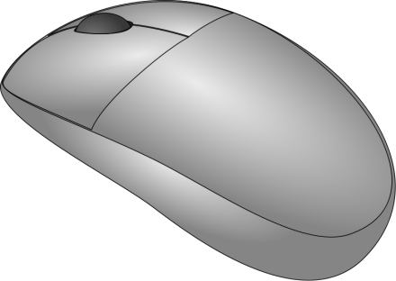

Human Interface Device
Indira Gandhi Delhi Technical University for Women
Team Members
Shruti Bhatia
Archi Jain
Supriya

Slide 2
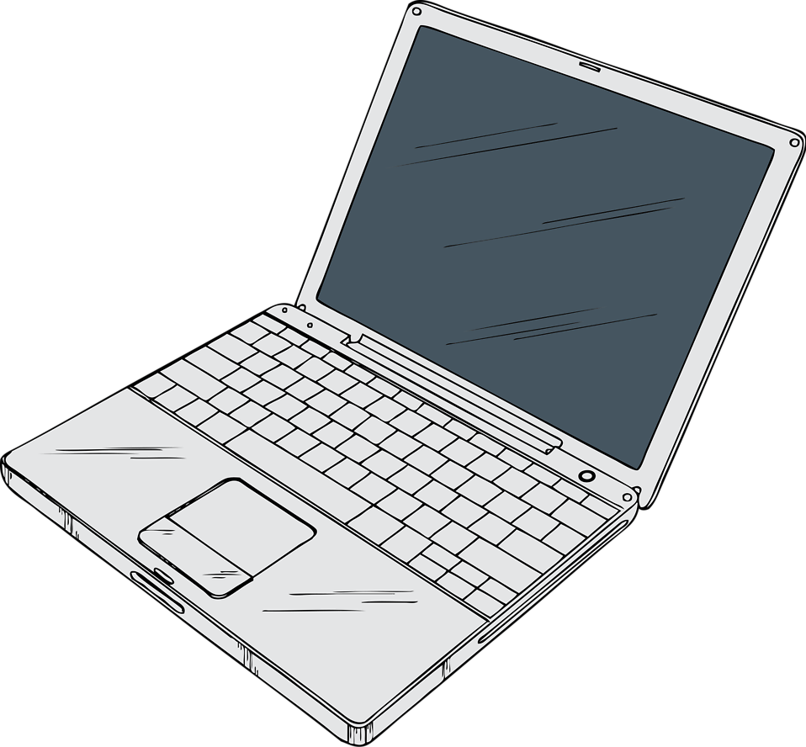
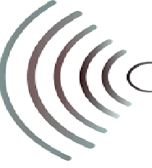

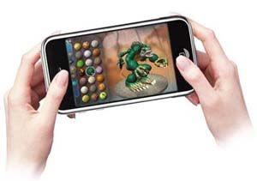
OUTPUT DEVICE:
Computer Screen
INPUT DEVICE:
Gaming Controller

Slide 3
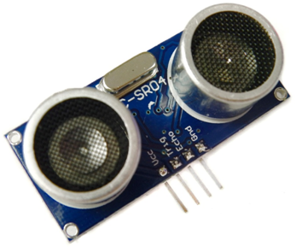
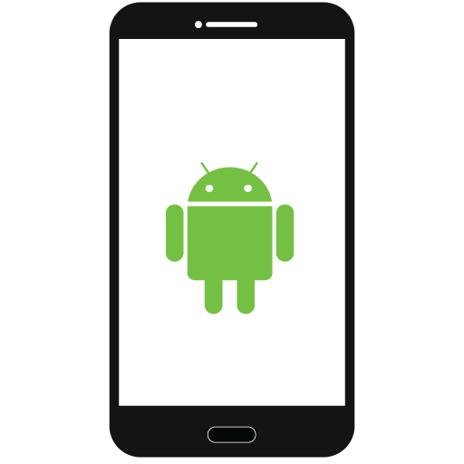
Gaming Controller
Smart Phone installed with application to control the game with the accelerometer of the device.
Ultrasonic Sensors are used For Speed Control And Brake Control

Slide 4
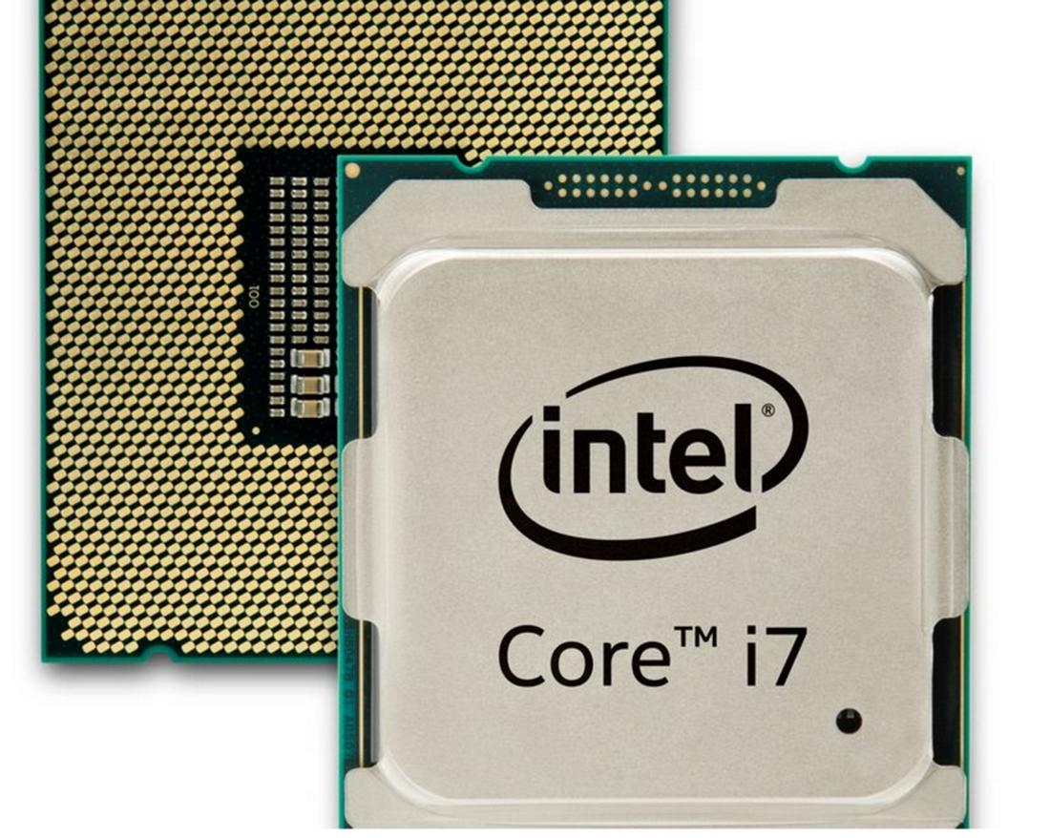
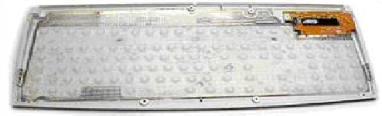
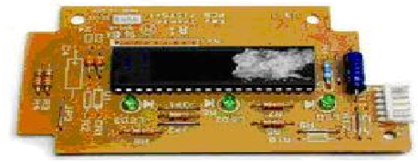
Communication between CPU and Keyboard
The Keyboard communicates the Input with the Interrupt present in Computer

Slide 5

As per Wikipedia, Human Interface Device is a computer peripheral that helps in communication with the Virtual World. So we have devised a way to communicate with the Virtual world using a simple and economical hack. The equipment used as Computer Peripherals are usually costly so in this world of technology we need an all purpose device which is easy on our pocket too.

Slide 6

Circuit Connections

Slide 7
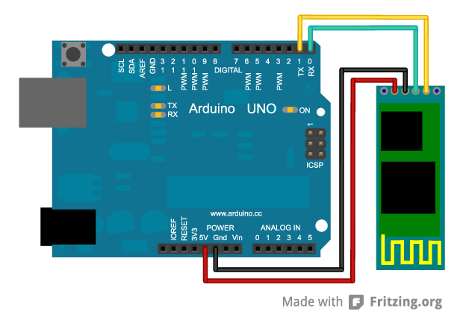

Mobile App Enabled with Accelerometer
Communication Using Bluetooth
Thus the Arduino sends the instruction to CPU of computer to control the game according to the orientation of the device.

Slide 8
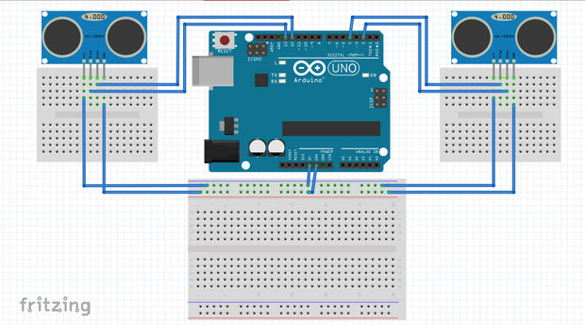
Ultrasonic sensor used for Speed Control
Ultrasonic sensor used for Brake Control

Slide 9

Advantages Over Conventional Gaming

Slide 10

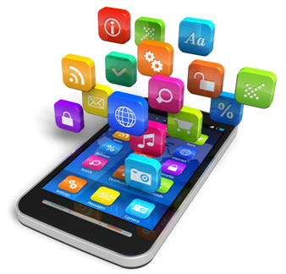
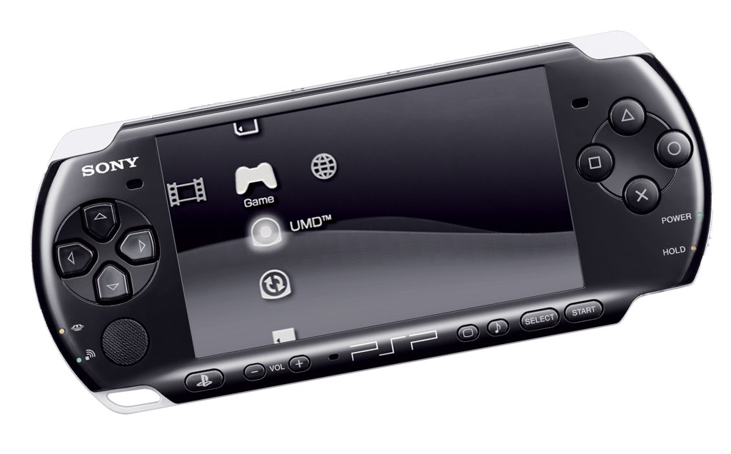
Economical
In Comparison to Costly Conventional Gaming Equipment, It only involves Downloading a Free app from the Android PlayStore

Slide 11
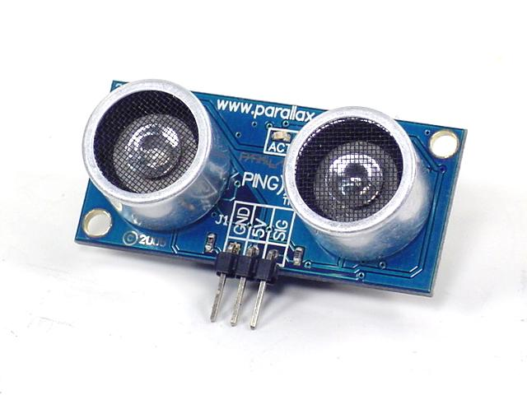
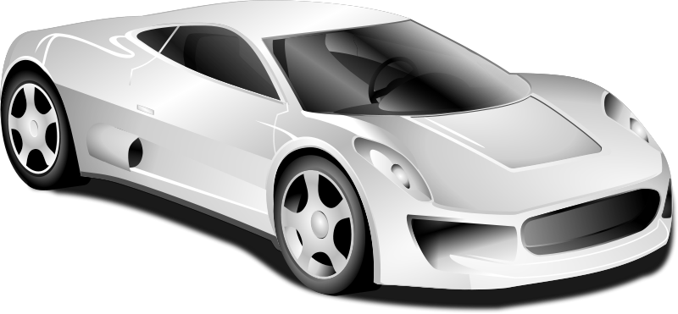
Provides 5D Experience
The Ultrasonic sensors that are being used for Braking and Speed Control gives a Real Life touch to the Gaming Experience

